Slide 1
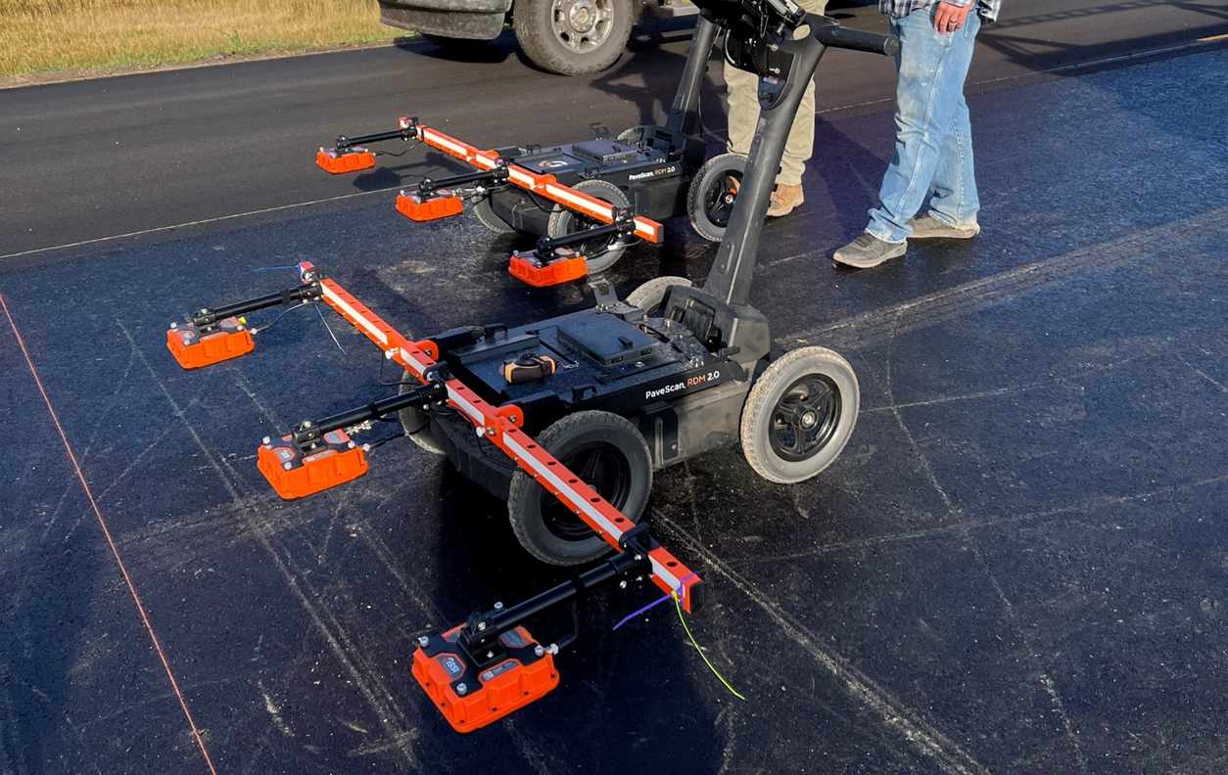

Density Profiling System Research in North Dakota
Jon Stork, P.E.

Slide 2
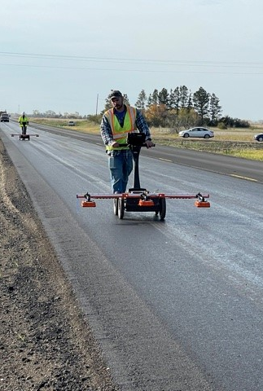
Density Profiling System Research
Need for continuous, non-destructive testing on HMA roadways
  GSSI PaveScan RDM 2.0
TPF-5(443): Continuous Asphalt Mixture Compaction Assessment using Density Profiling System (DPS)
  NDDOT Committed from 2020-2022

Slide 3
DPS Projects in ND

Slide 4
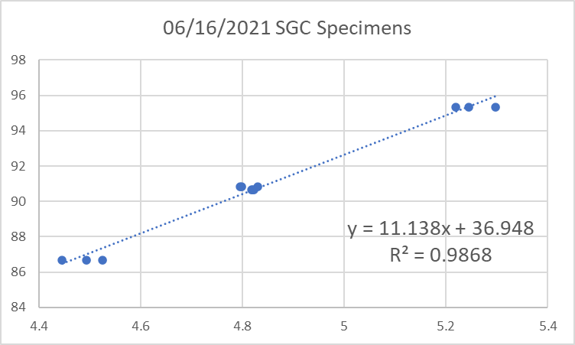
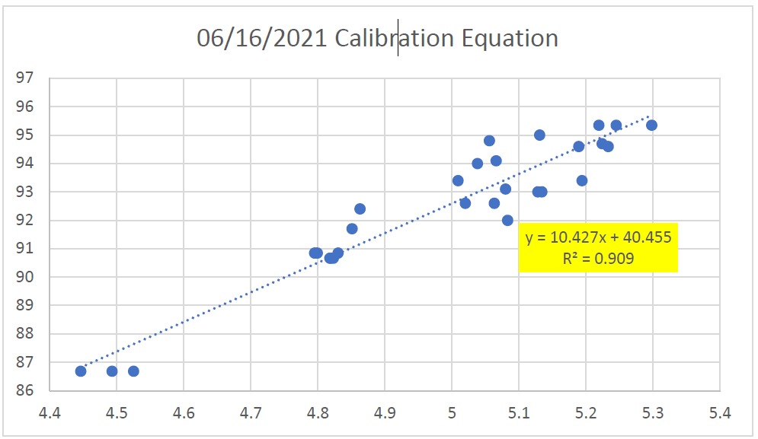
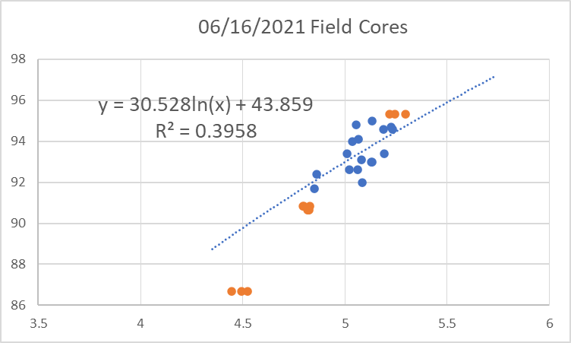
Dielectric to Density – ND 32

Slide 5
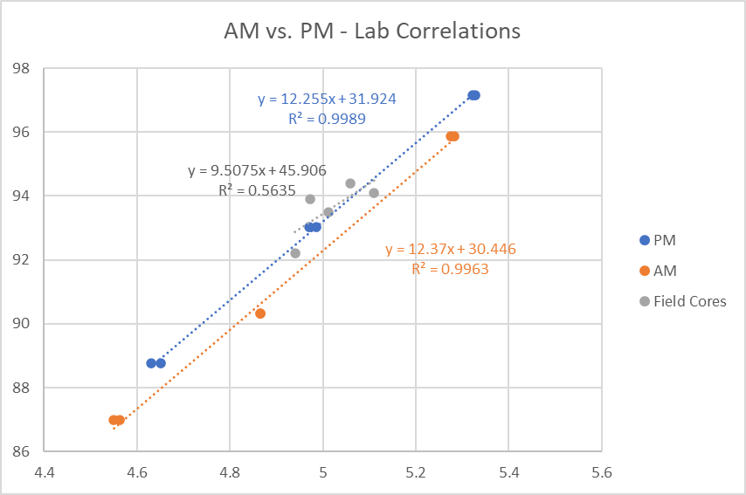
Mix Production - Sensitivity
Test 8-1 to 8-3
+0.12% AC
-0.8% AV
No blend changes
+0.8% moisture

Slide 6
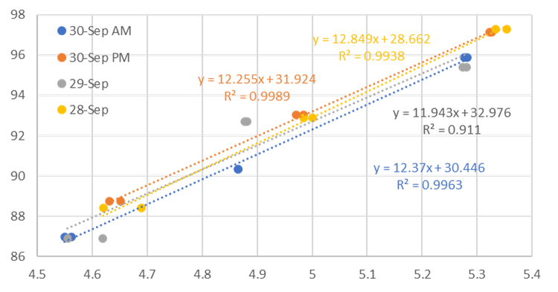
US 83 – Daily Comparison

Slide 7
NDDOT Research Findings - 2021

Slide 8
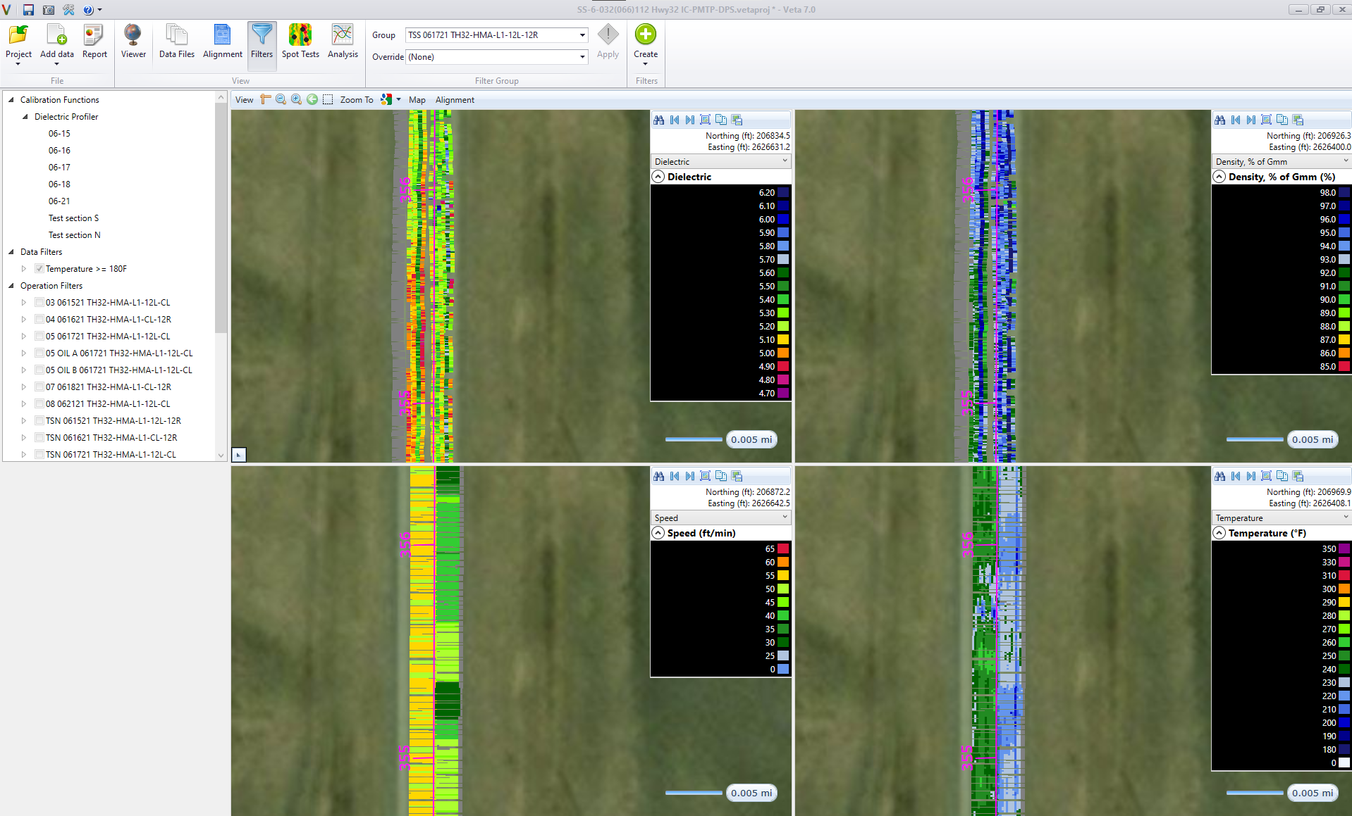

Slide 9
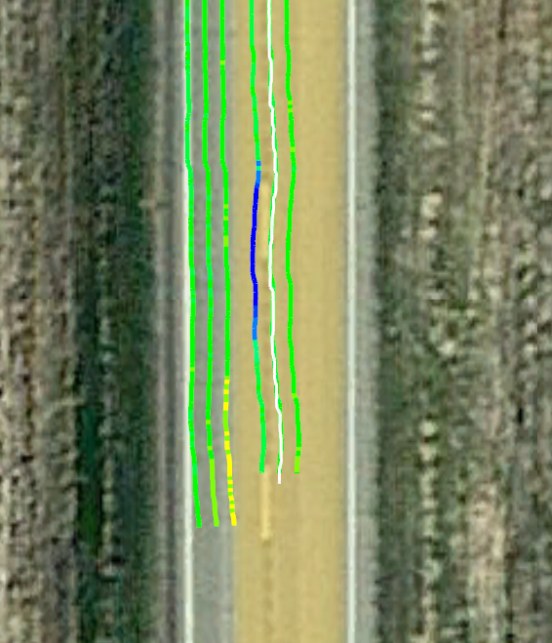
Tips, Tricks & Lessons Learned – PaveScan 2.0
Spare set of RDM batteries
$200 / battery
5-6 hours of collection / set
2. GPS upgrade
Stock unit: Garmin GLO 2
95% <3m accuracy

Slide 10
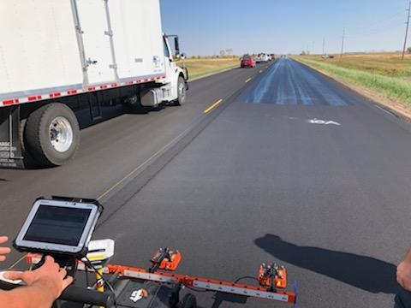
Fog Seal
When to collect?
Inconsistent coverage
Process delays

Slide 11
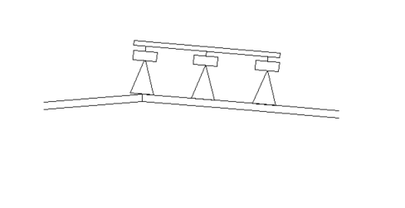
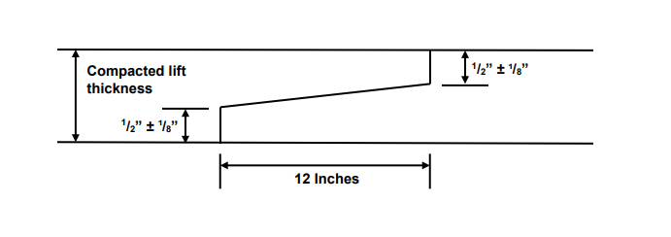
Joints
Geometry
Double-tacked joints
Notched-wedge joint

Slide 12
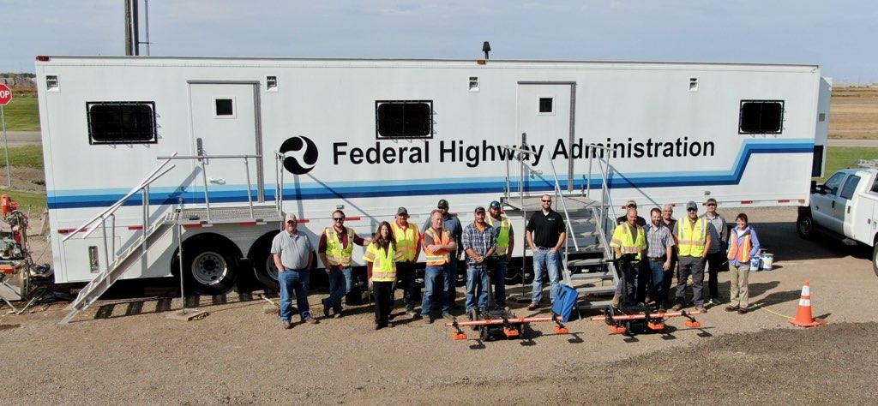
Final Thoughts
Uniformity!
Consistent HMA production/construction
Try it.
Questions?
Jon Stork, NDDOT Material & Research
jstork@nd.gov (701) 328-6903

